Slide 1
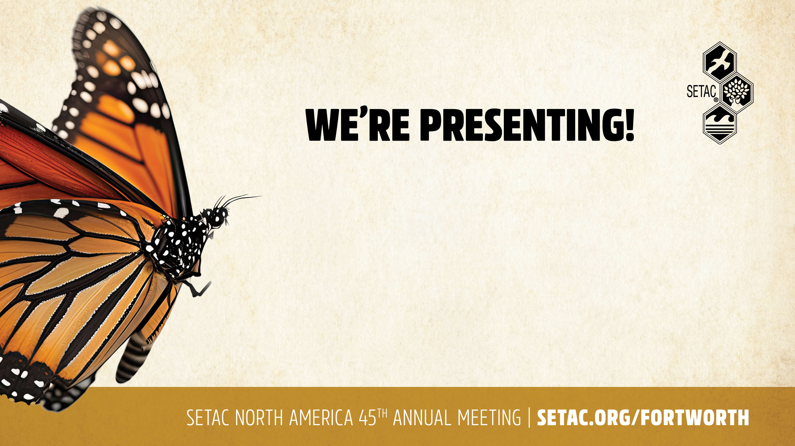
Plastics of All Sizes in the Environment
John Doe | 10:00 CDT | 21 October
Risk Assessment in the 21st Century
Jane Smith | 13:30 CDT | 21 October
Impact of Climate Change on
Wildlife Biodiversity
Kate Kennedy | 10:00 CDT | 22 October

